Slide 1
Part 1: Python basic

Slide 2
CONTENTS
2
Part 1: Python basics
Getting Started with Jupyter Notebook
Variables and simple data types
Lists, Tuples, Sets and Dictionaries
Conditional Statements and while loops
Function and class (OPP)

Slide 3
Outline
3. Lists, Tuples, Sets and Dictionaries
3.1 Lists
What Is a List?
Changing, Adding, and Removing Elements
Organizing a List
Avoiding index errors when working with lists

Slide 4
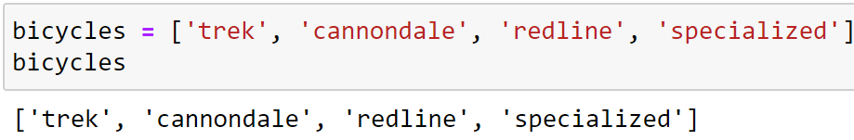
What Is a List?
A list stores a series of items in a particular order.
Lists allow you to store sets of information in one place, whether you have just a few items or millions of items.
Lists are one of Python's most powerful features readily accessible to new programmers, and they tie together many important concepts in programming.
Defining a list
Use square brackets ([]) to define a list, and use commas to separate individual items in the list.
Use plural names for lists, to make your code easier to read.

Slide 5
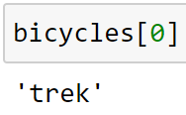
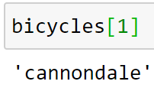
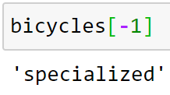
What Is a List?
Accessing elements
Individual elements in a list are accessed according to their position, called the index.
To get a particular element, write the list's name and then the element's index in square brackets.
Start
End
Index | $$0$$ | $$1$$ | $$2$$ | $$3$$
 | $$−4$$ | $$−3$$ | $$− 2$$ | $$−1$$
Negative index

Slide 6
Practice
3-1,...,3-3

Slide 7
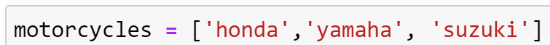
Changing, Adding, and Removing Elements
Changing:
list[index] = new_object
Adding:
list.append(object)
list.insert(index, object)
Removing:
del list[index]
pop the last item: list.pop(index=-1)
Remove first occurrence of value: list.remove(value)

Slide 8
Practice
3-4,…, 3.7

Slide 9
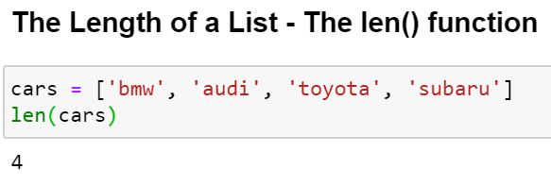
Organizing a List
alist.sort() method and sorted(alist) function
Method alist.sort(reverse=False): Sort the list in ascending order
Function sorted(iterable, reverse=False): Return a new list containing all items from the iterable in ascending order
len(cars): Return the number of items in cars

Slide 10
Practice
3-8,…, 3.10

Slide 11
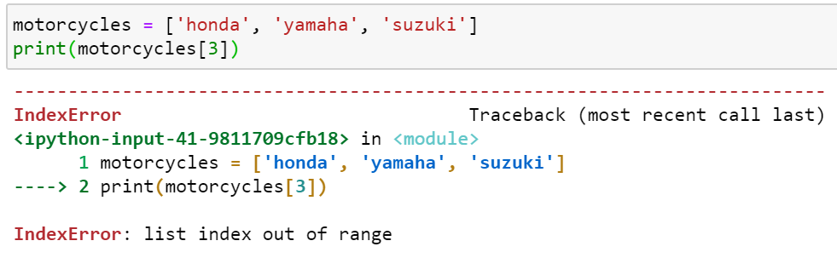
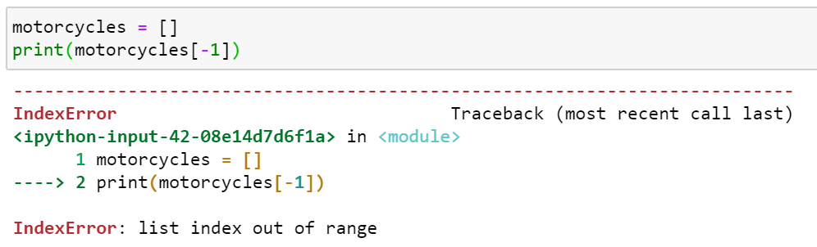
Avoiding Index Errors When Working with Lists

Slide 12
Python for loops and Tuple, Set
3.2. Python for loops and Tuple, Set
For loops
Making Numerical Lists
Working with Part of a List

Slide 13
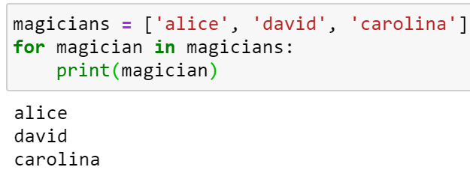
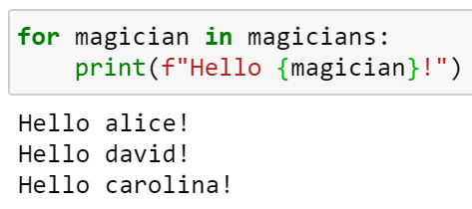
For loop
Looping Through an Entire List
A for loop is used for iterating over a collection (or sequence) (that is either a list, a tuple, a dictionary, a set, or a string)
Collection
Define a for loop
indent
Repeat

Slide 14
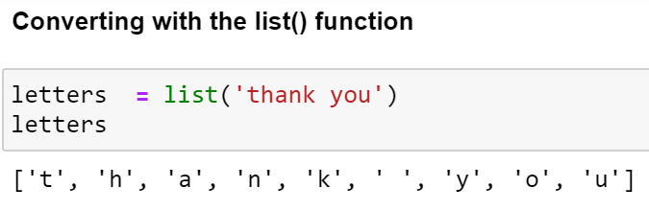
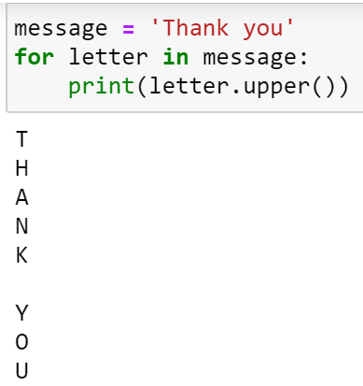
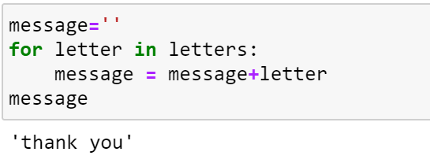
For loop
Looping Through a String

Slide 15
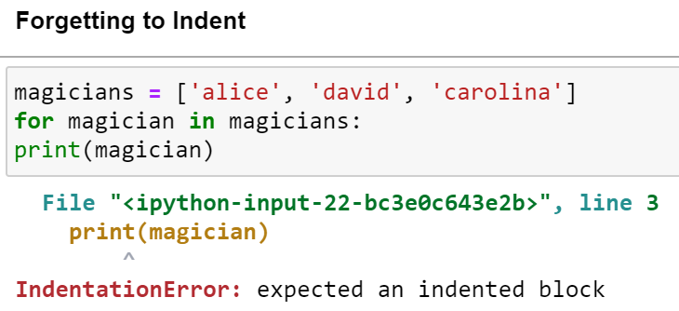
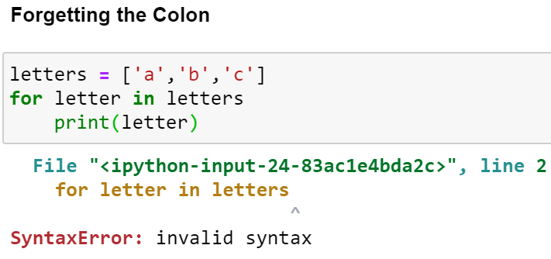
For loop
Avoiding Indentation Errors

Slide 16
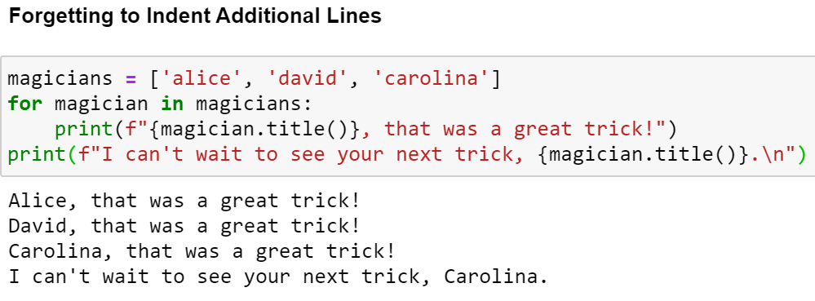
For loop

Slide 17
Practice
4-1, 4-2

Slide 18
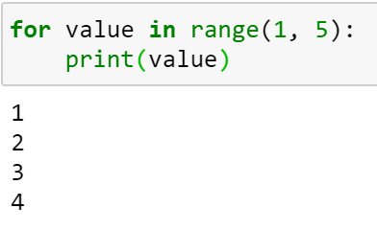

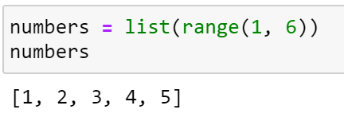
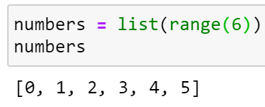
Making Numerical Lists
Using the range() Function
Start
Stop
Start
1
Stop
Using range() to Make a List of Numbers
Start = 0

Slide 19
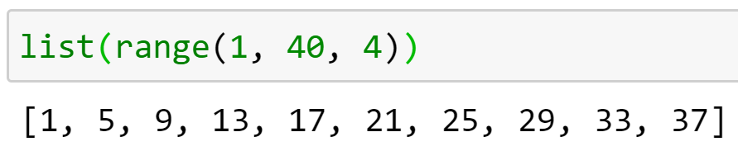
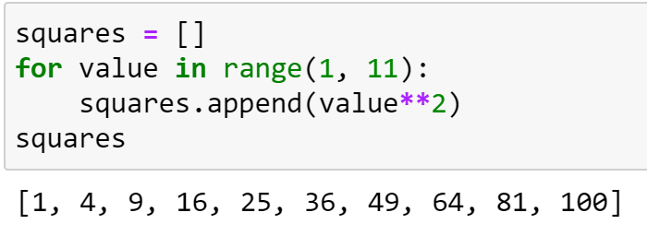
Making Numerical Lists
Start
Stop
Step
Step
First 10 square numbers into a list

Slide 20
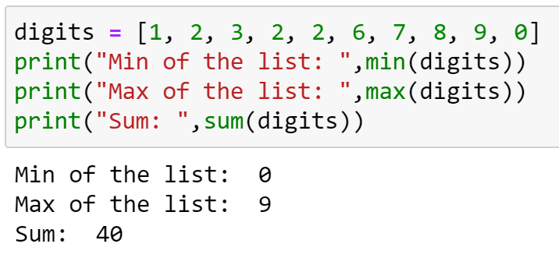


Making Numerical Lists
Simple Statistics with a List of Numbers
The dir() function: returns all properties and methods of the specified object, without the values.

Slide 21
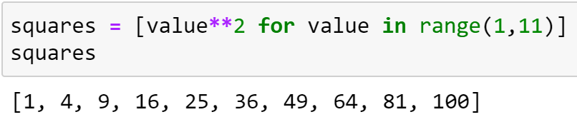
Making Numerical Lists
List Comprehensions
First 10 square numbers into a list

Slide 22
Practice
4-3,…, 4-9

Slide 23
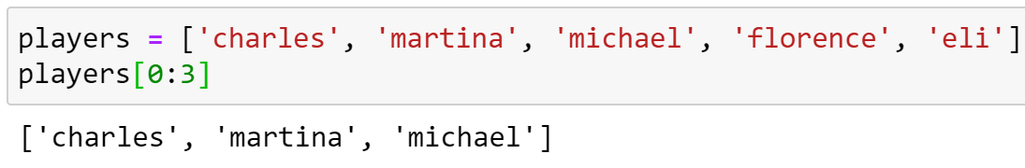
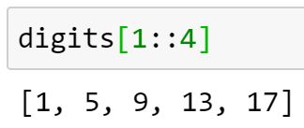
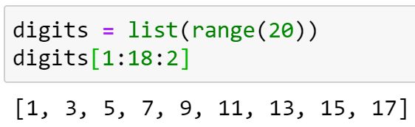
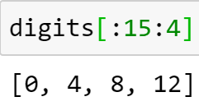
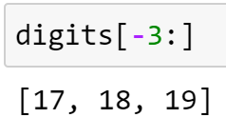
Working with Part of a List
Slicing a List
[start: stop: step]
slice
Start
Stop
Step

Slide 24
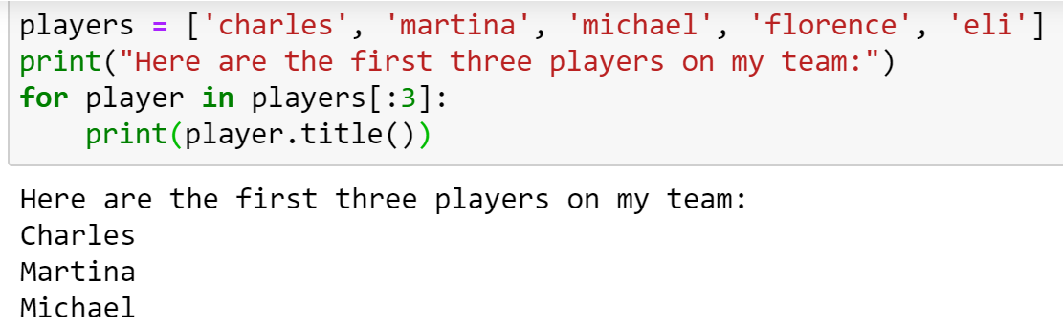
Working with Part of a List
Looping Through a Slice

Slide 25
Practice
4-10, 4-11

Slide 26
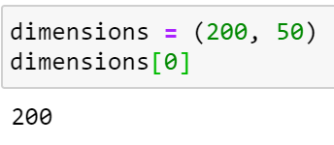
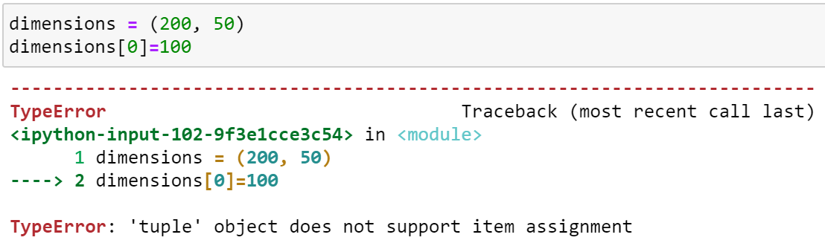
Tuples
Defining a Tuple: A tuple looks just like a list
except you use parentheses instead of square brackets.
except you can't change the values in a tuple once it's defined

Slide 27
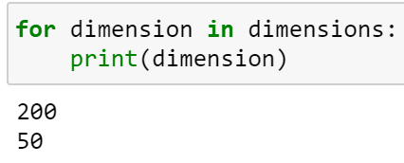
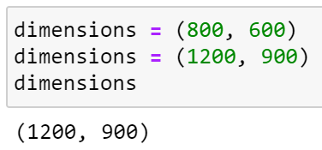
Tuples
Looping through a tuple
Overwriting a tuple

Slide 28
Practice
4-13

Slide 29
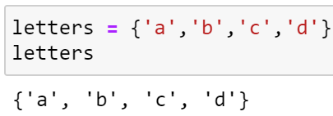
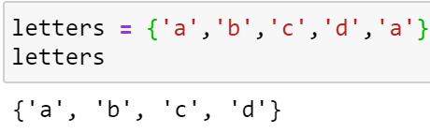
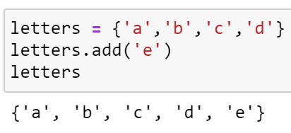
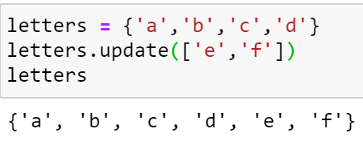
Sets
Defining a Set: A set is a collection which is unordered and unindexed. In Python sets are written with curly brackets.
Change items: you cannot change its items.
Add: use the add() or update() methods

Slide 30
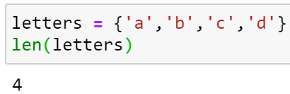
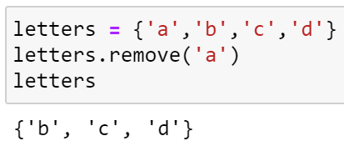
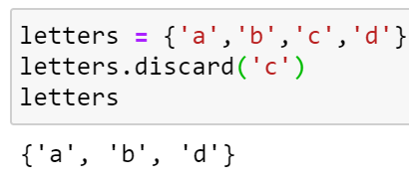
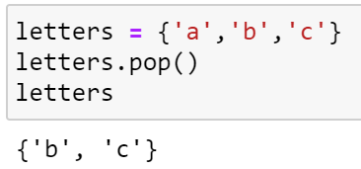
Sets
The Length of a Set
Note: If the item to remove does not exist, discard() will NOT raise an error.
Remove Item
Note: Sets are unordered, so when using the pop() method, you will not know which item that gets removed.

Slide 31
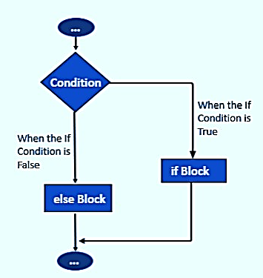
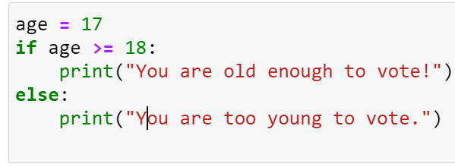

If Statements
if-else Statements

Slide 32
Practice
Create a set from a string, list and tuple.
How many letters and words are there in the following message?
message = ‘’’ (import this) ‘’’
3*. Split a paragraph of text into smaller paragraphs less than number_char = 61 characters in size and rejoin paragraphs by "\n\n". Note: The cutting point should be at the end of the sentence, except if not possible, leave it in the space position.
Input: "ChatGPT is an AI assistant.\n\n It understands natural language.\n\n It helps answer questions fast.\n\n It can assist with writing \n\ntasks.\n\n ChatGPT learns from vast data.\n\nIt adapts to user needs well.\n\n This AI is by OpenAI's team.\n\n It's built to aid and inform.\n\n Ask ChatGPT anything today!“
Output: "ChatGPT is an AI assistant. It understands natural language.\n\n It helps answer questions fast.\n\n It can assist with writing tasks.\n\n ChatGPT learns from vast data.It adapts to user needs well.\n\n This AI is by OpenAI's team. It's built to aid and inform.\n\n Ask ChatGPT anything today!“
**: Try with file input.txt and number_char = 5000
# Đọc nội dung từ file input.txt
with open('input.txt', 'r', encoding='utf-8') as file:
text_to_translate = file.read()
...
# Lưu kết quả vào file output.txt
with open('output.txt', 'w', encoding='utf-8') as file:
file.write(output_text.strip())

Slide 33
Dictionaries
3.3. Dictionaries
Working with Dictionaries
Looping Through a Dictionary
Nesting

Slide 34
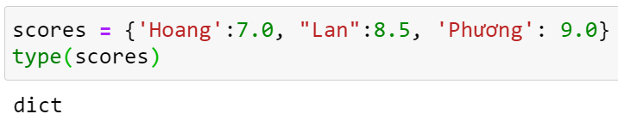

Working with Dictionaries
A Simple Dictionary
key
value
Defining a dictionary Use curly braces to define a dictionary. Use colons to connect keys and values, and use commas to separate individual key-value pairs.

Slide 35
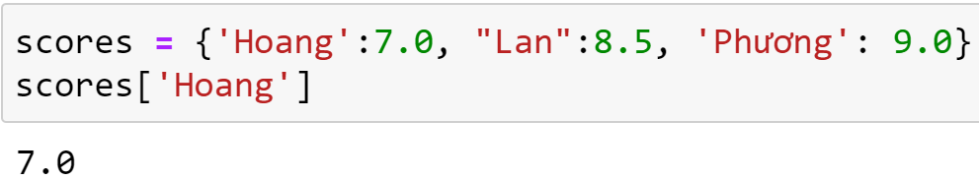
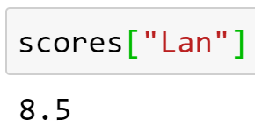
Working with Dictionaries
Accessing Values in a Dictionary

Slide 36
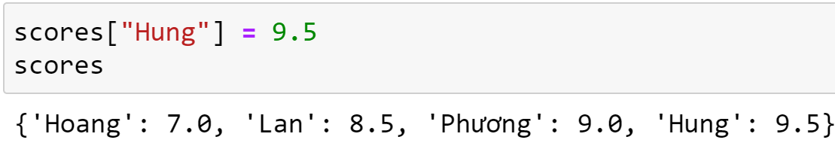
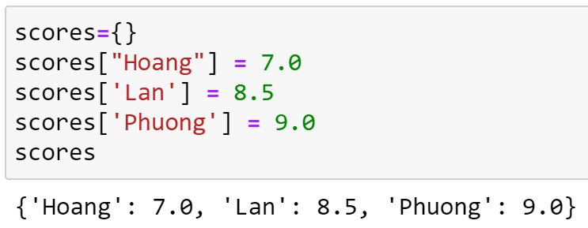
Working with Dictionaries
Adding New Key-Value Pairs
Starting with an Empty Dictionary

Slide 37
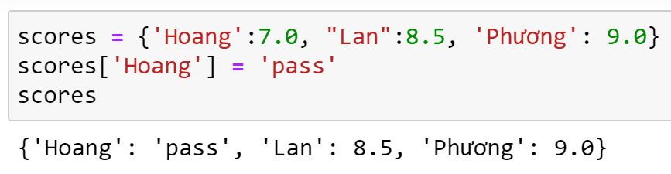
Working with Dictionaries
Modifying Values in a Dictionary

Slide 38
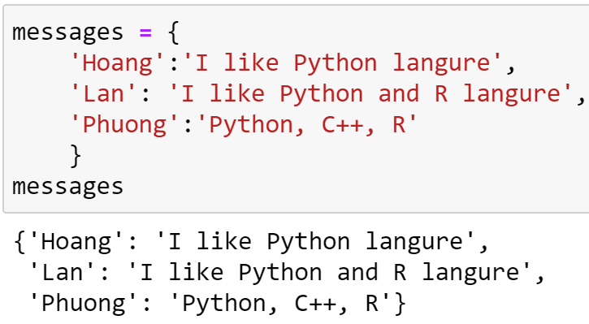
Working with Dictionaries
A Dictionary of Similar Objects

Slide 39



Working with Dictionaries
Using get() to Access Values

Slide 40


Looping Through a Dictionary
Looping Through All Key-Value Pairs

Slide 41


Looping Through a Dictionary
Looping Through All the Keys in a Dictionary

Slide 42


Looping Through a Dictionary
Looping Through All Values in a Dictionary

Slide 43


Nesting
A List of Dictionaries
A List in a Dictionary

Slide 44

Nesting
A Dictionary in a Dictionary

Slide 45
Practice
message = ‘’’
(import this)
‘’’
1. Count the frequency of words in the message (Not case sensitive).
Output is a dictionary with the key as the word and values as its frequency
2. Find all sentences containing words (meaningful, not prepositions, articles, auxiliary verbs...) with the highest frequency.

Slide 46
Sumary
Prop. Type | Collection | Ordered | Changeable | Duplicate members | Indexed
List | ● | ● | ● | ● | ●
Tuple | ● | ● |  | ● | ●
Set | ●
Dictionaries | ● |  | ● |  | ●

